Slide 1

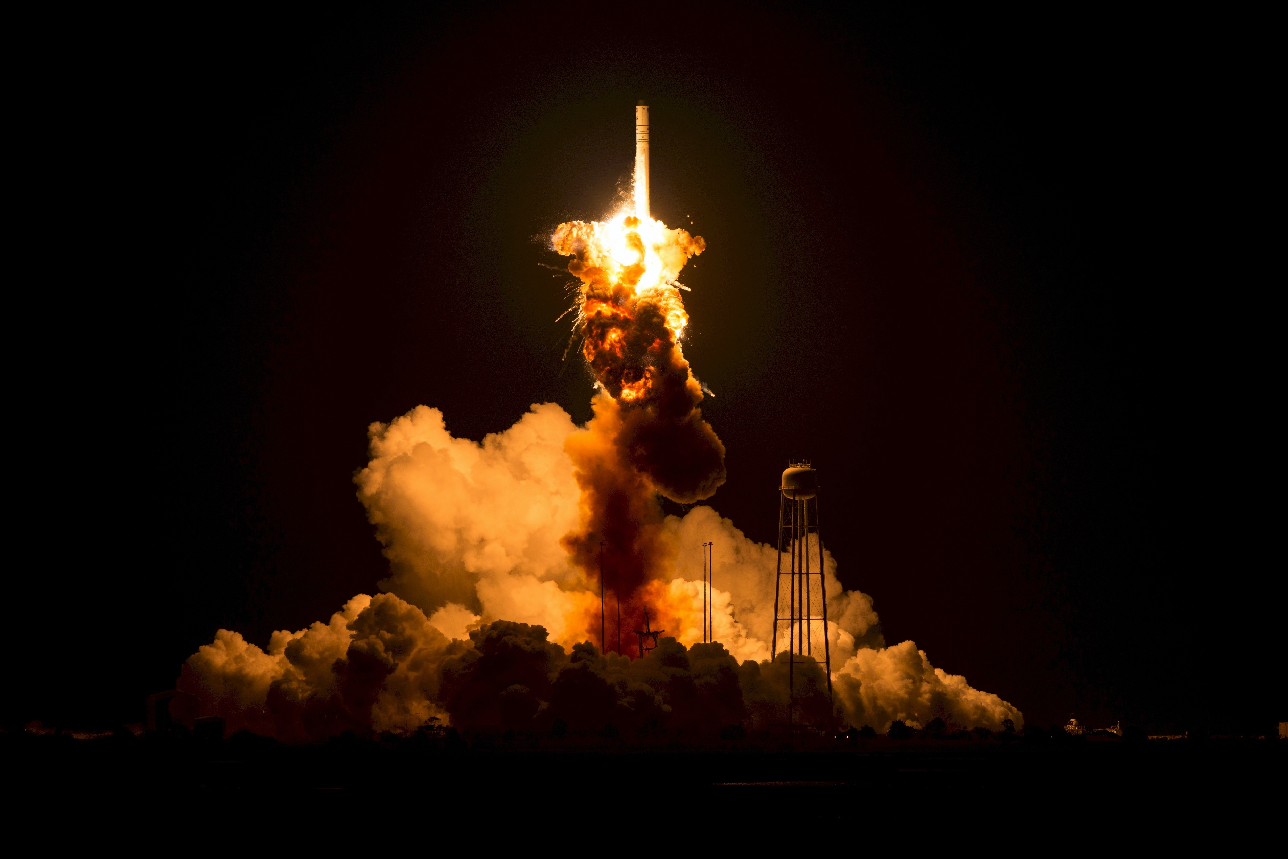
APPLIED DATA SCIENCE CAPSTONE RPOJECT
OPERATION SPACEX OUTCOME PREDICTION(A Machine Learning Approach)
SETHU S
22 JULY 2023

Slide 2
OUTLINE
EXECUTIVE SUMMARY
INTRODUCTION
METHODOLOGY
RESULTS
CONCLUSION
APPENDIX
GITHUB URL:
https://github.com/itsmesethus/courserac10assignments/tree/main/applied%20data%20science%20capstone%20project%20works

Slide 3
EXECUTIVE SUMMARY
SUMMARIES OF METHODOLOGY:
1) Collecting the SpaceX history data using API ,
Web scrapping from Wikipedia source.
2) Data Preprocessing (handling missing values,
data integrity checking, data quality and etc.)
3) EDA with Structured Query Language
4) EDA with Pandas and Matplotlib libraries(Python)
5) Interactive and Visualizing Dashboard( Folium, Plotly and
Dash)
6) Predictive Analytics with Machine Learning for SpaceX rockets
landing.
SUMMARIES OF RESULTS:
Data Visualizations
Best Machine Learning Model for Prediction of SpaceX landing

Slide 4
INTRODUCTION
"As long as there are dreams, rockets will forever carry the hope of mankind beyond the horizon."
SpaceX advertises Falcon 9 rocket launches on its website, with a cost of 62 million dollars; other providers cost upward of 165 million dollars each, much of the savings is because SpaceX can reuse the first stage. Therefore if we can determine if the first stage will land, we can determine the cost of a launch. This information can be used if an alternate company wants to bid against SpaceX for a rocket launch.
We, hereby going to travel with the process of our Data Science Team and how they have worked to solve this problem of SpaceX Organisation before their next launch of rockets into the orbit whether it will be succeful or loss for them based on their previous history launches. So, okay let’s dive into the presentation of the Team.

Slide 5

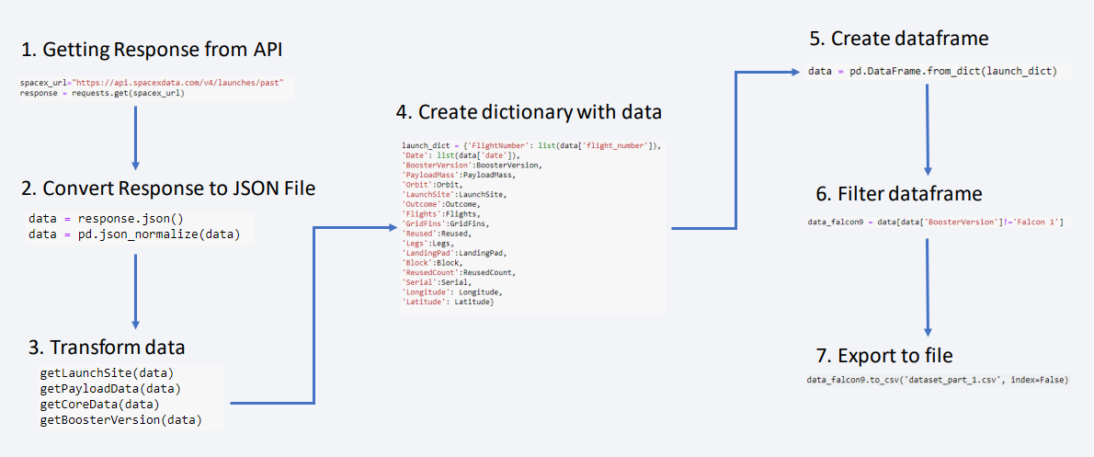
METHODOLOGY
DATA COLLECTION ----- (Rest API, Web Scrapping):
* Using the Rest API we extract the data from the source in the form of JSON and later we can easily turn that format
to data frame using the help of Pandas library of Python.
* For Web Scrapping we can use the BeautifulSoup and request libraries to scrap out the data from the Wikipedia
source.
https://github.com/itsmesethus/coursera-c10-assignments/blob/main/applied%20data%20science%20capstone%20project%20works/Week1%20SpaceX%20Falcon%20Data%20Collection-Wrangling.ipynb

Slide 6
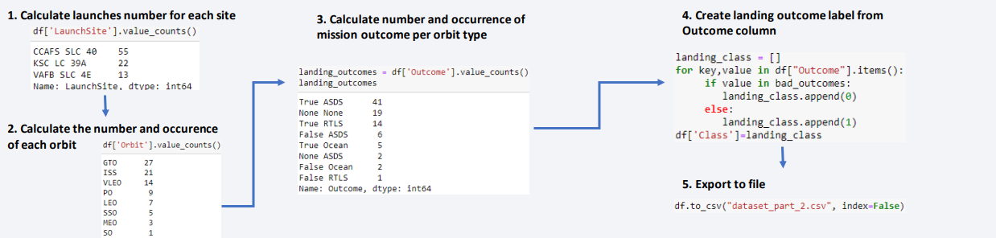
DATA PREPROCESSING :
* Here in this section we need to look for the data integrity, data quality and handling the missing values will be considered.
* Because if data is n’t in correct format or any other possibilities the results may mislead to wrong predictions.
https://github.com/itsmesethus/coursera-c10-assignments/blob/main/applied%20data%20science%20capstone%20project%20works/Week1%20SpaceX%20Falcon%20Data%20Collection-Wrangling.ipynb

Slide 7
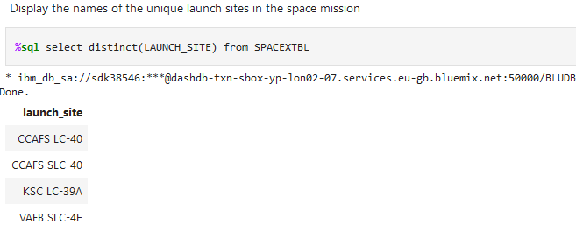
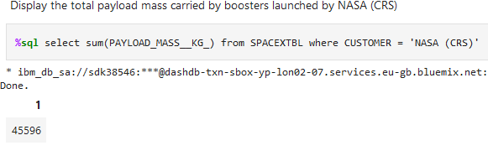
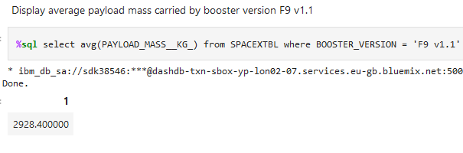
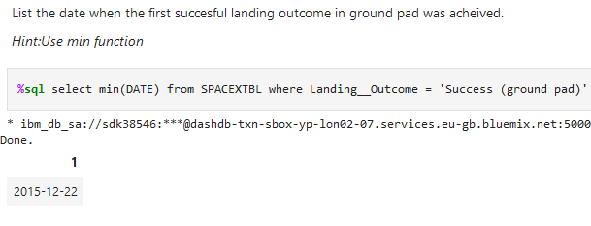
EDA WITH STRUCTURED QUERY LANGUAGE:
* SQL is the best programming language when handling in terms of huge volumes of data. Using this we have done the
EDA for the Falcon 9 rockets. And some results are,

Slide 8
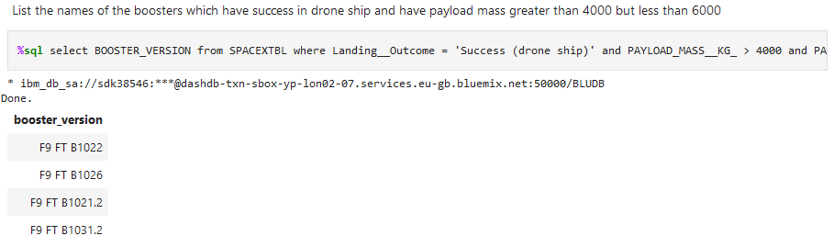
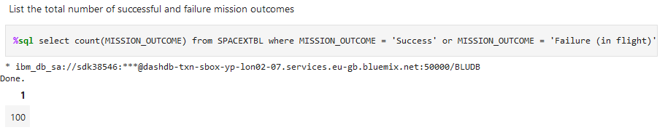
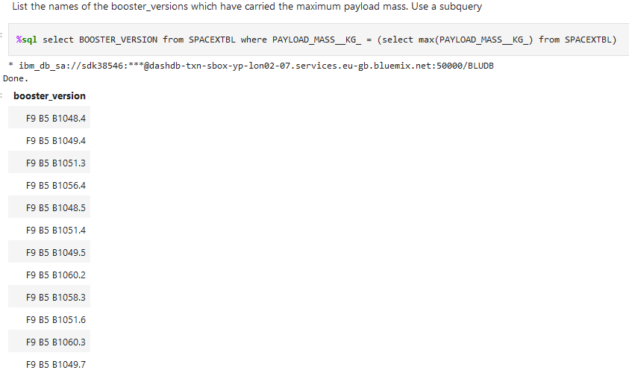
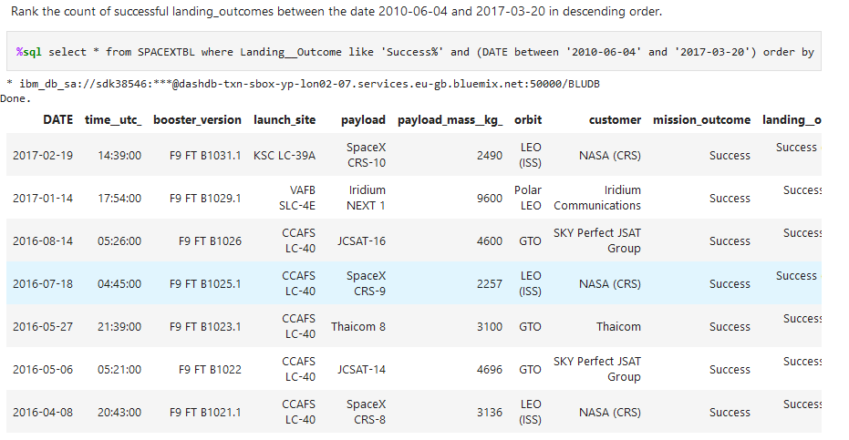

Slide 9
EDA WITH MATPLOTLIB AND PANDAS:
* Matplotlib and Pandas are the most versatile libraries in Python for handling the visualizations and data frames.
Scatter Graphs :
• Flight Number vs. Payload Mass
• Flight Number vs. Launch Site
• Payload vs. Launch Site
• Orbit vs. Flight Number
• Payload vs. Orbit Type
• Orbit vs. Payload Mass
Line Graph:
• Success rate vs. Year
Bar Graph :
• Success rate vs. Orbit

Slide 10
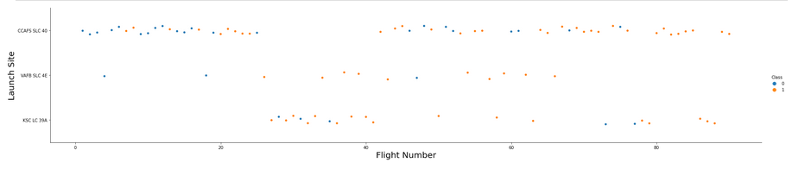
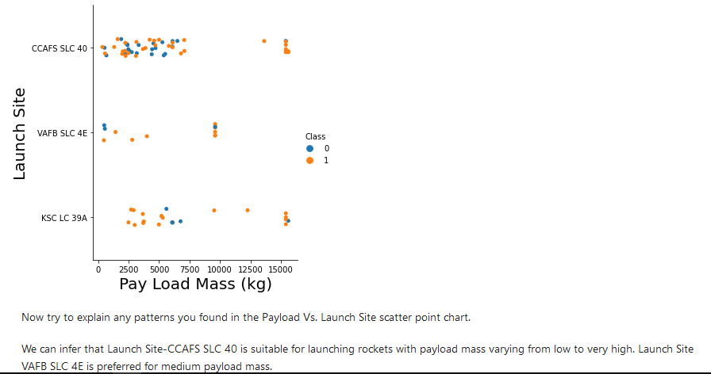
EDA REASULTS:

Slide 11
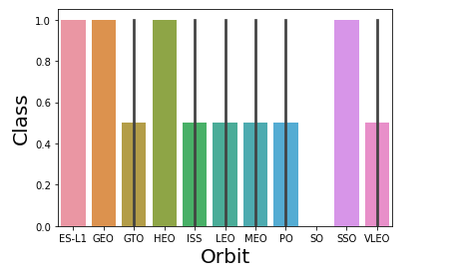
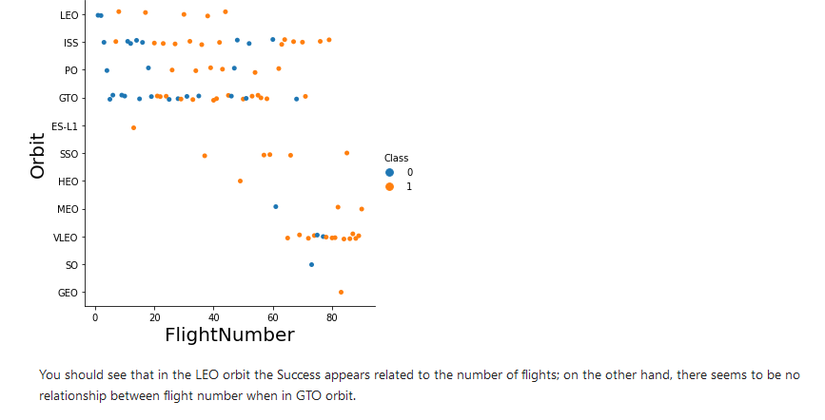
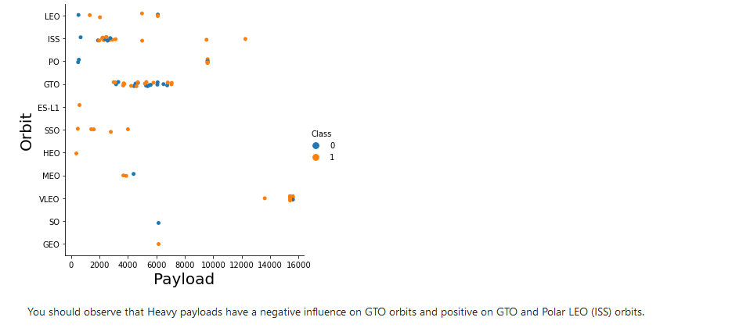
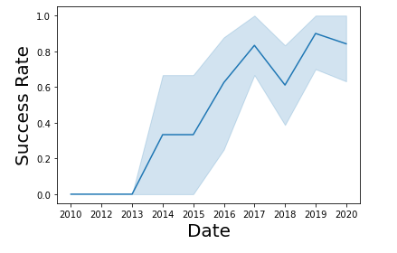
YEAR 2019 have the high no of rocket success rates than other years.

Slide 12
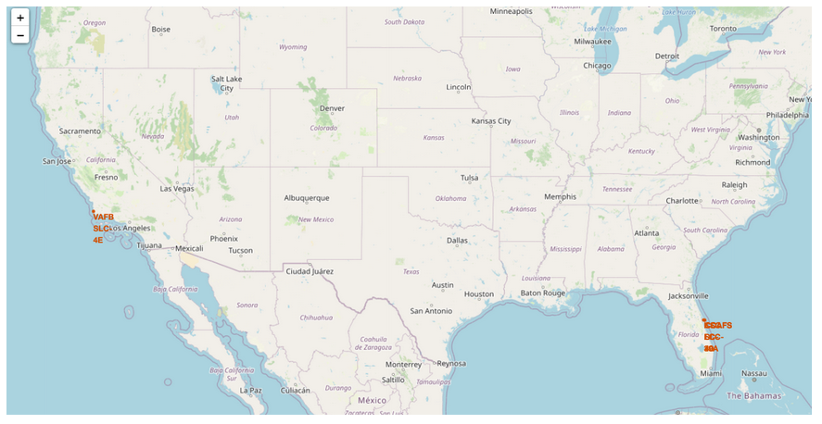
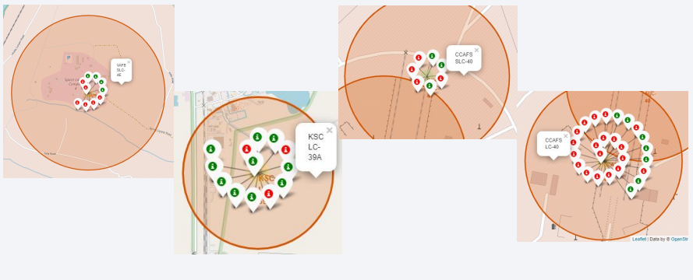
VISUALIZATIONS (FOLIUM MAPS)
Launch Sites
Red : faliures
Green: Success

Slide 13
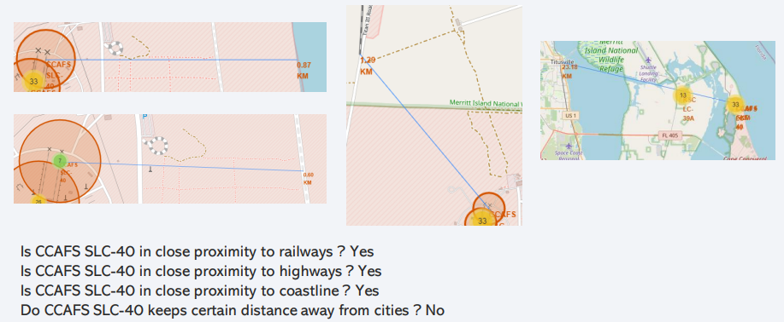

Slide 14
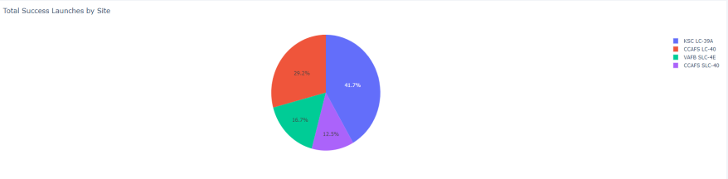
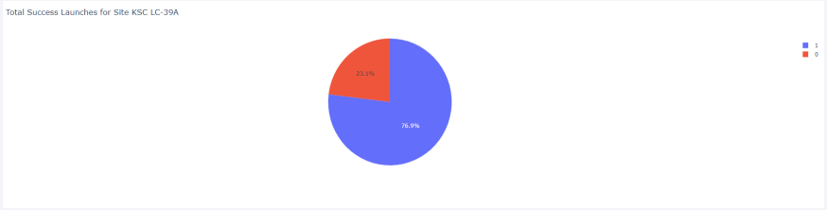
PLOTLY:
KSC LC-39A has the best success rate of launches.
KSC LC-39A has achieved a 76.9% success rate while getting a 23.1% failure rate.

Slide 15
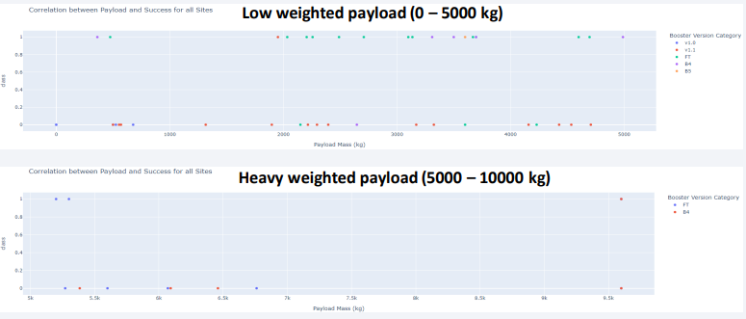
Low weighted payloads have a better success rate than the heavy weighted payloads.

Slide 16
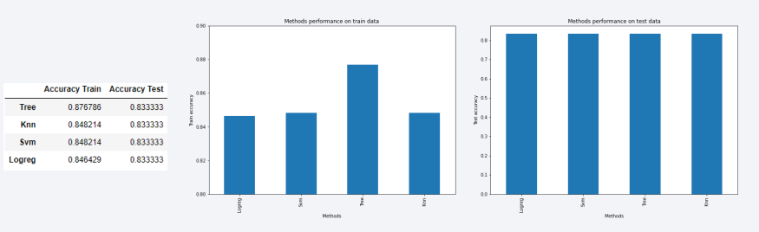
PREDICTIVE ANALYSIS:
For accuracy test, all methods performed similar. We could get more test data to decide between them. But if we really need to choose one right now, we would take the decision tree.

Slide 17
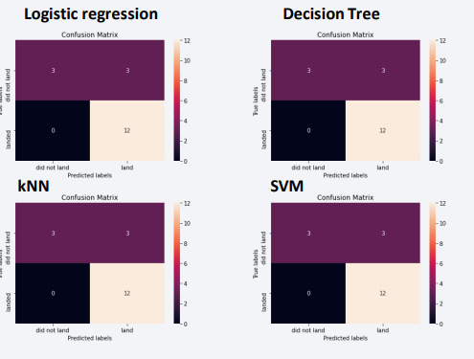

Slide 18
CONCLUSION:
*The success of a mission can be explained by several factors such as the launch site, the orbit and especially the number of previous launches. Indeed, we can assume that there has been a gain in knowledge between launches that allowed to go from a launch failure to a success.
• The orbits with the best success rates are GEO, HEO, SSO, ES-L1.
• Depending on the orbits, the payload mass can be a criterion to take into account for the success of a mission. Some orbits require a light or heavy payload mass. But generally low weighted payloads perform better than the heavy weighted payloads.
• With the current data, we cannot explain why some launch sites are better than others (KSC LC-39A is the best launch site). To get an answer to this problem, we could obtain atmospheric or other relevant data.
• For this dataset, we choose the Decision Tree Algorithm as the best model even if the test accuracy between all the models used is identical. We choose Decision Tree Algorithm because it has a better train accuracy.

Slide 19
THANK YOU!

